Slide 1
Usability of Stock Prediction Trading apps
Wall Street Bulls

Slide 2
Group Members
Pooan Dhameliya : 201601450
Darshan Kapadiya : 201601179
Anand Pipaliya : 201601457
Ketul Solanki : 201601241
Kunal Jani : 201601444

Slide 3
Applications We considered For Our Survey
Yahoo Finance
Money Control
ShareKhan

Slide 4
Tasks We Gave For Assessment Of The Apps
Create Watch List
We Gave Task to add 3 Shares in wish list for all 3 applications
Survey :
Total Number of Survey : 34
Yahoo Finance Users : 10
Sharekhan Users : 15
Money control Users : 18

Slide 5
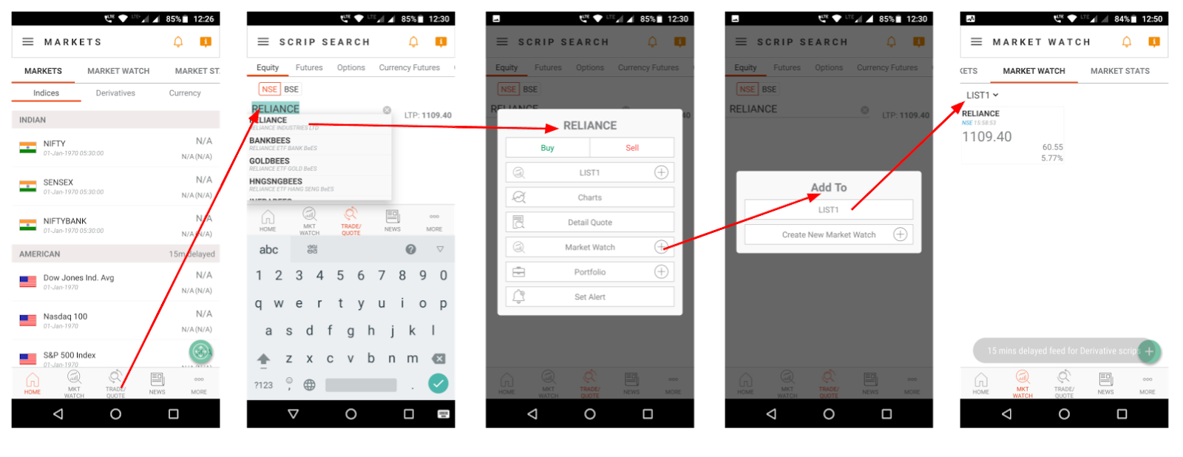
Interaction Mapping
Sharekhan

Slide 6
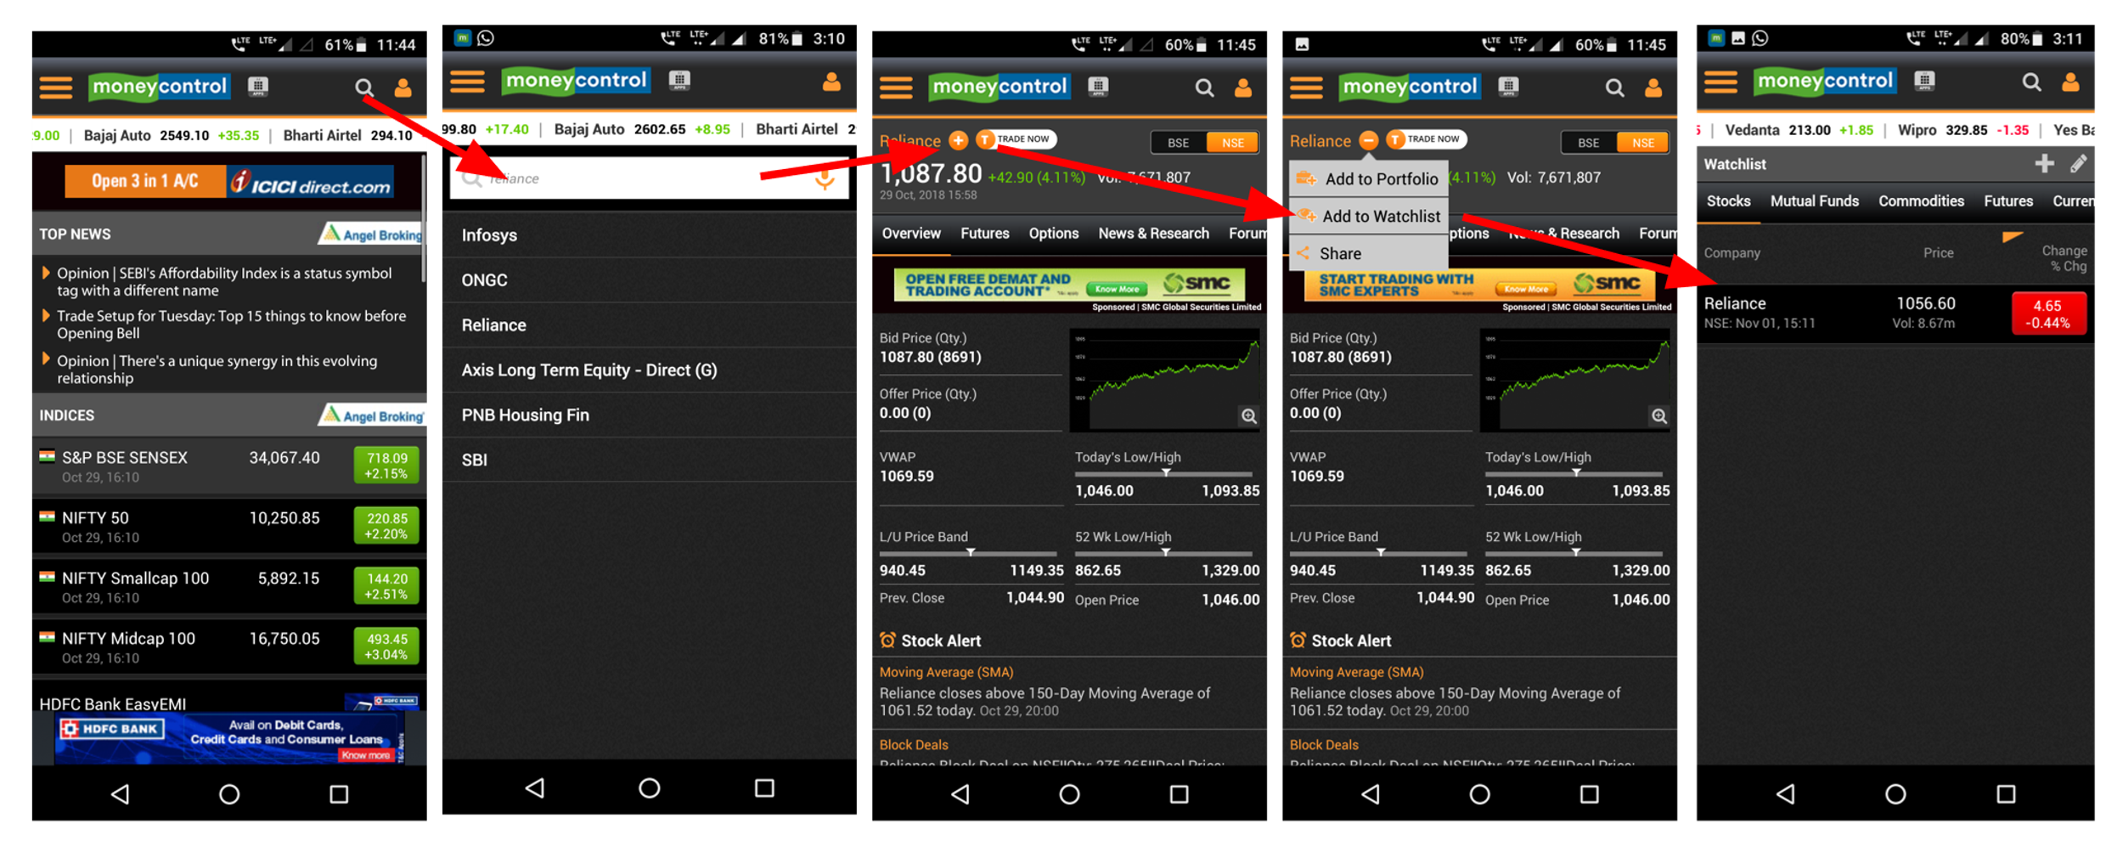
Money Control

Slide 7
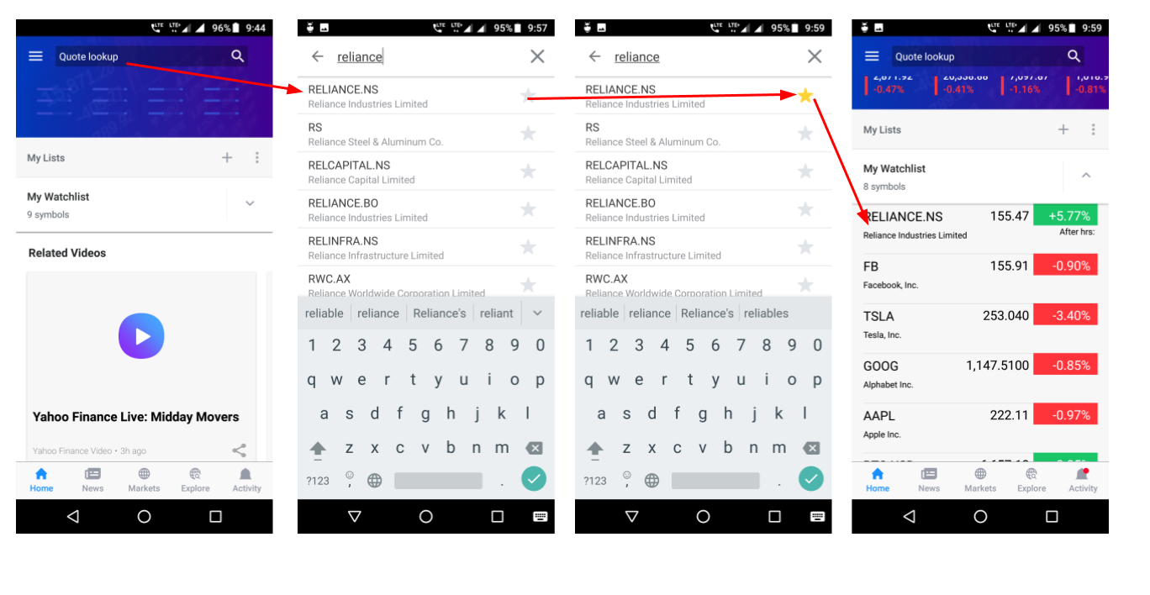
Yahoo Finance
Yahoo Finance Does this in 3 Steps
So we ware expecting that yahoo will take minimum time to create wish list.

Slide 8
Time Taken By users to create wish list
Average For all Apps
Money Control :37.4
Yahoo Finance :31.7
Sharekhan :42.6

Slide 9
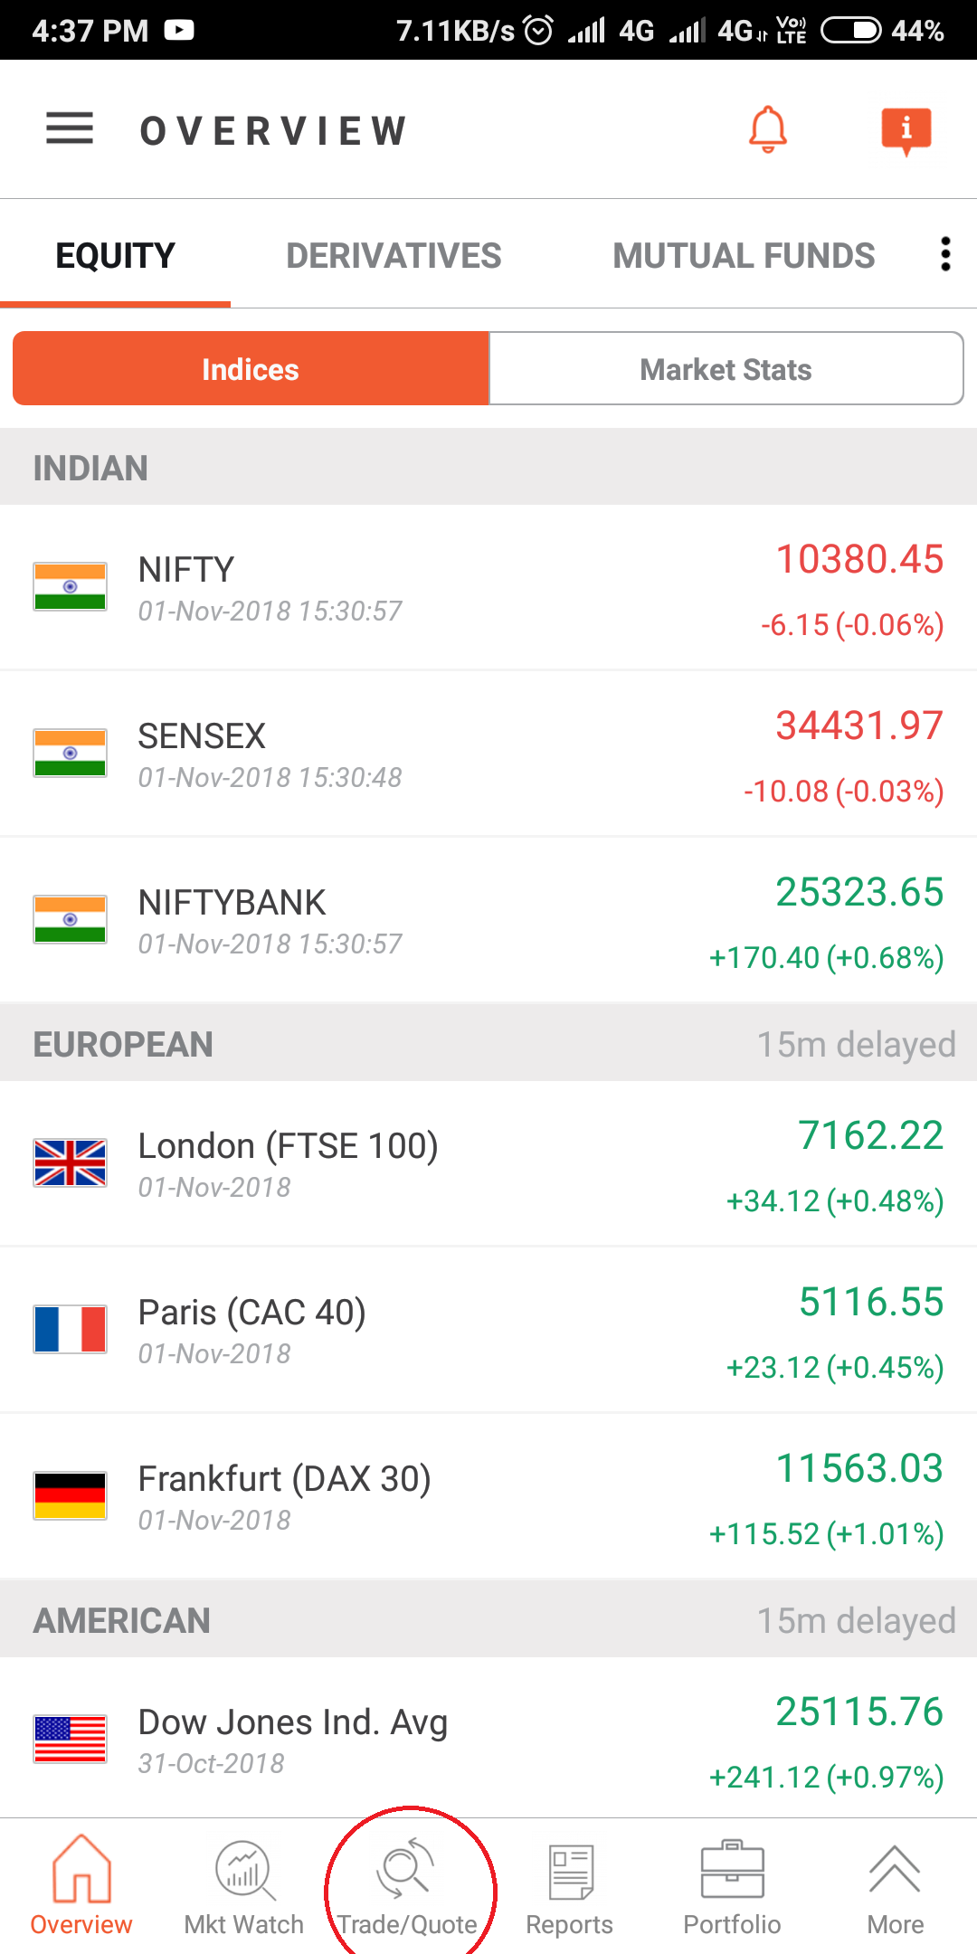
Analysis of apps Using Golden Rules
1)Strive for consistency:
In sharekhan app, the search button is quite hard to find as it is in awkward position rather than the predetermined position.

Slide 10
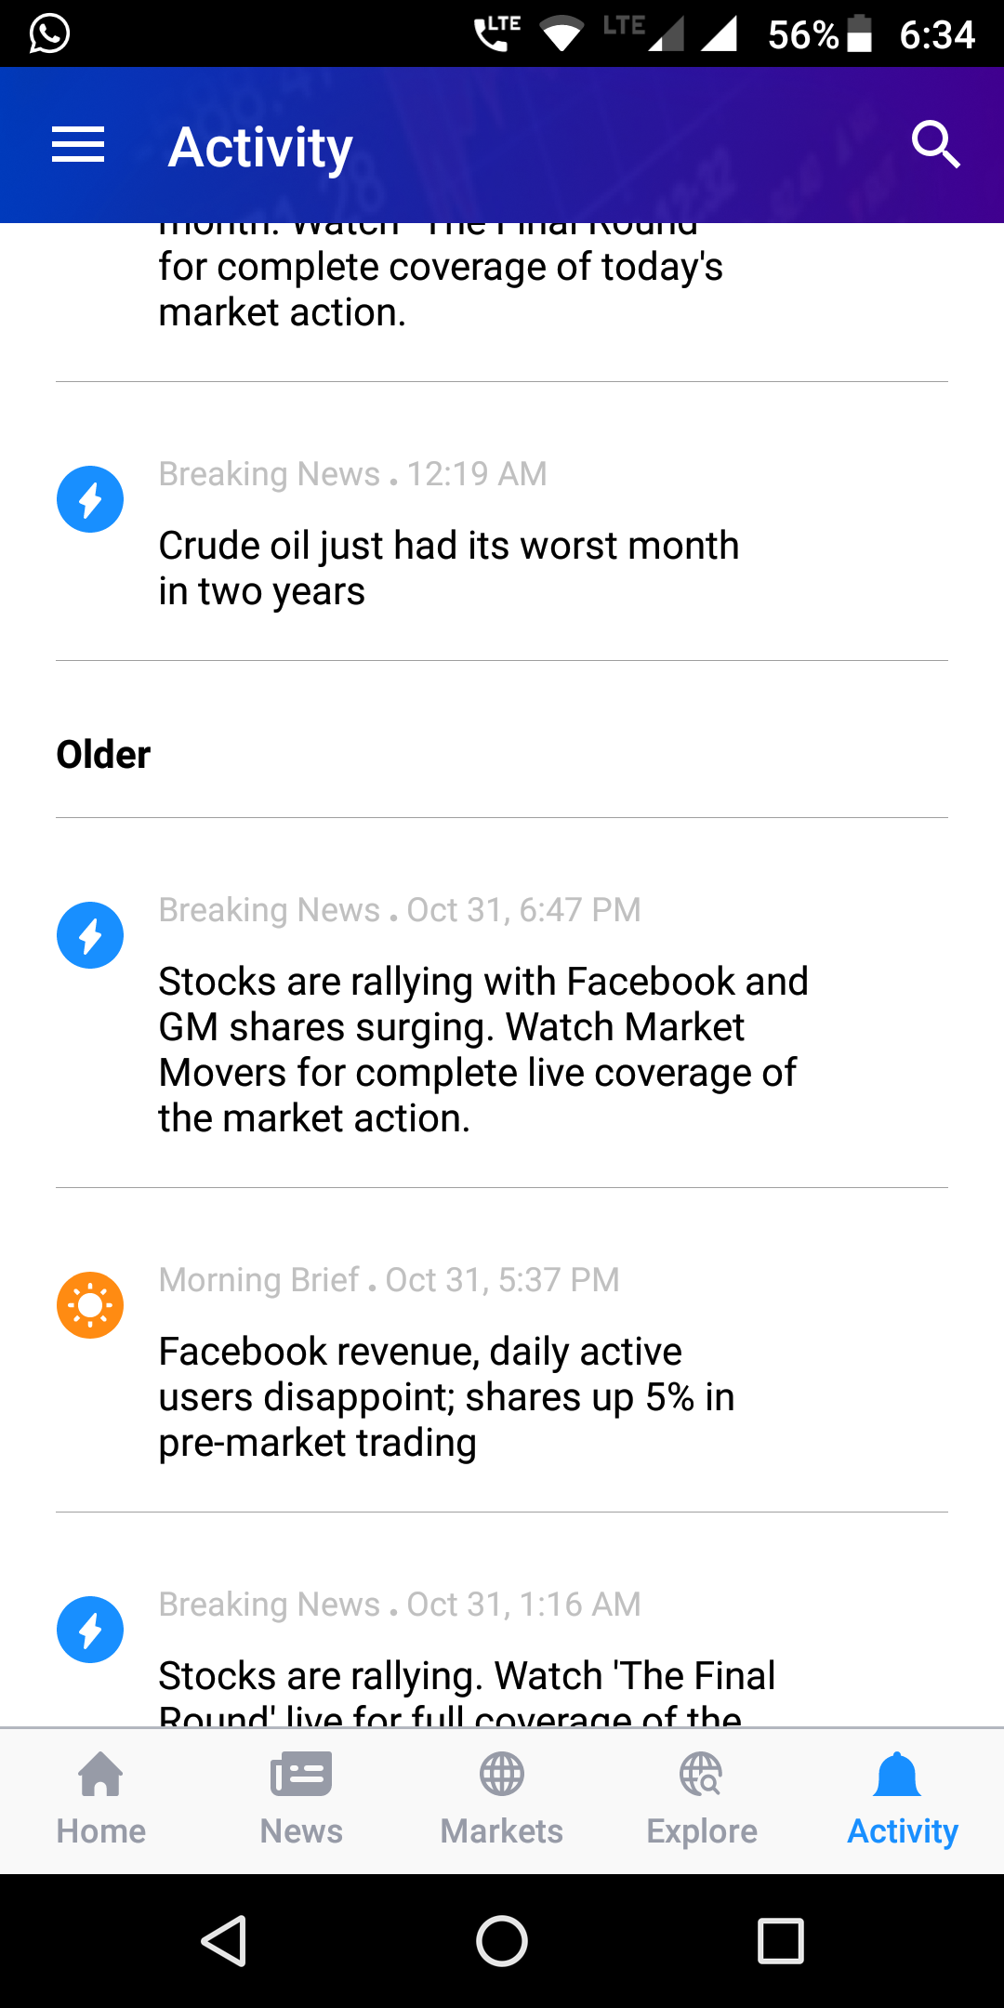
Strive for Consistency
The Activity button in Yahoo Finance which has symbol of bell is generally used for notification rather than news feed of market activity.

Slide 11
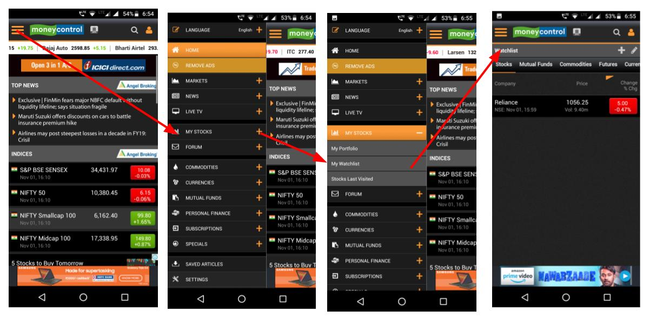
2) Enable to use Shortcuts
All the frequently used buttons in money control app like portfolios, watchlist are not on main home page due to which we aren’t able to quickly access to it.

Slide 12
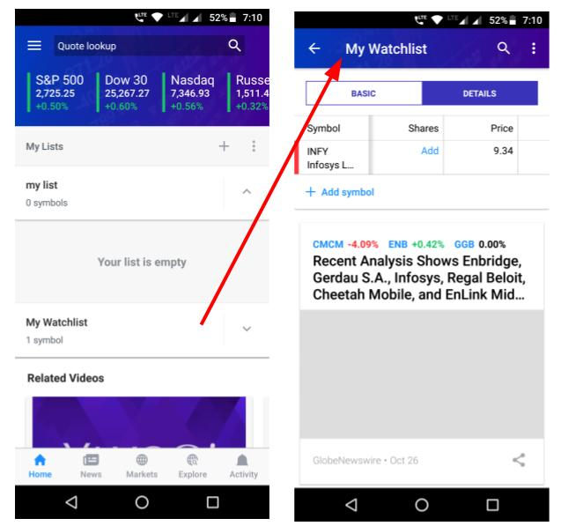
2) Enable to use Shortcuts
Yahoo Finance has watchlist on the home page which helps to user for quickly accessing it.

Slide 13
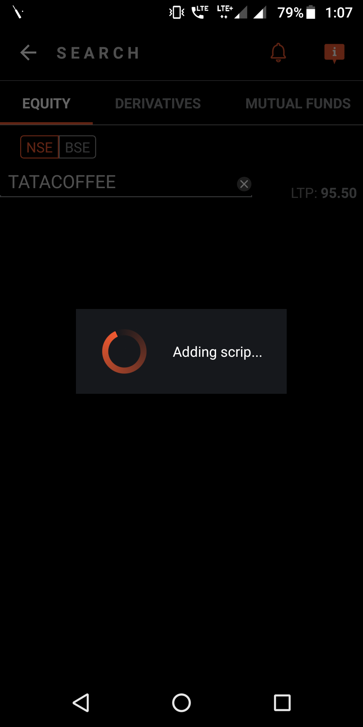
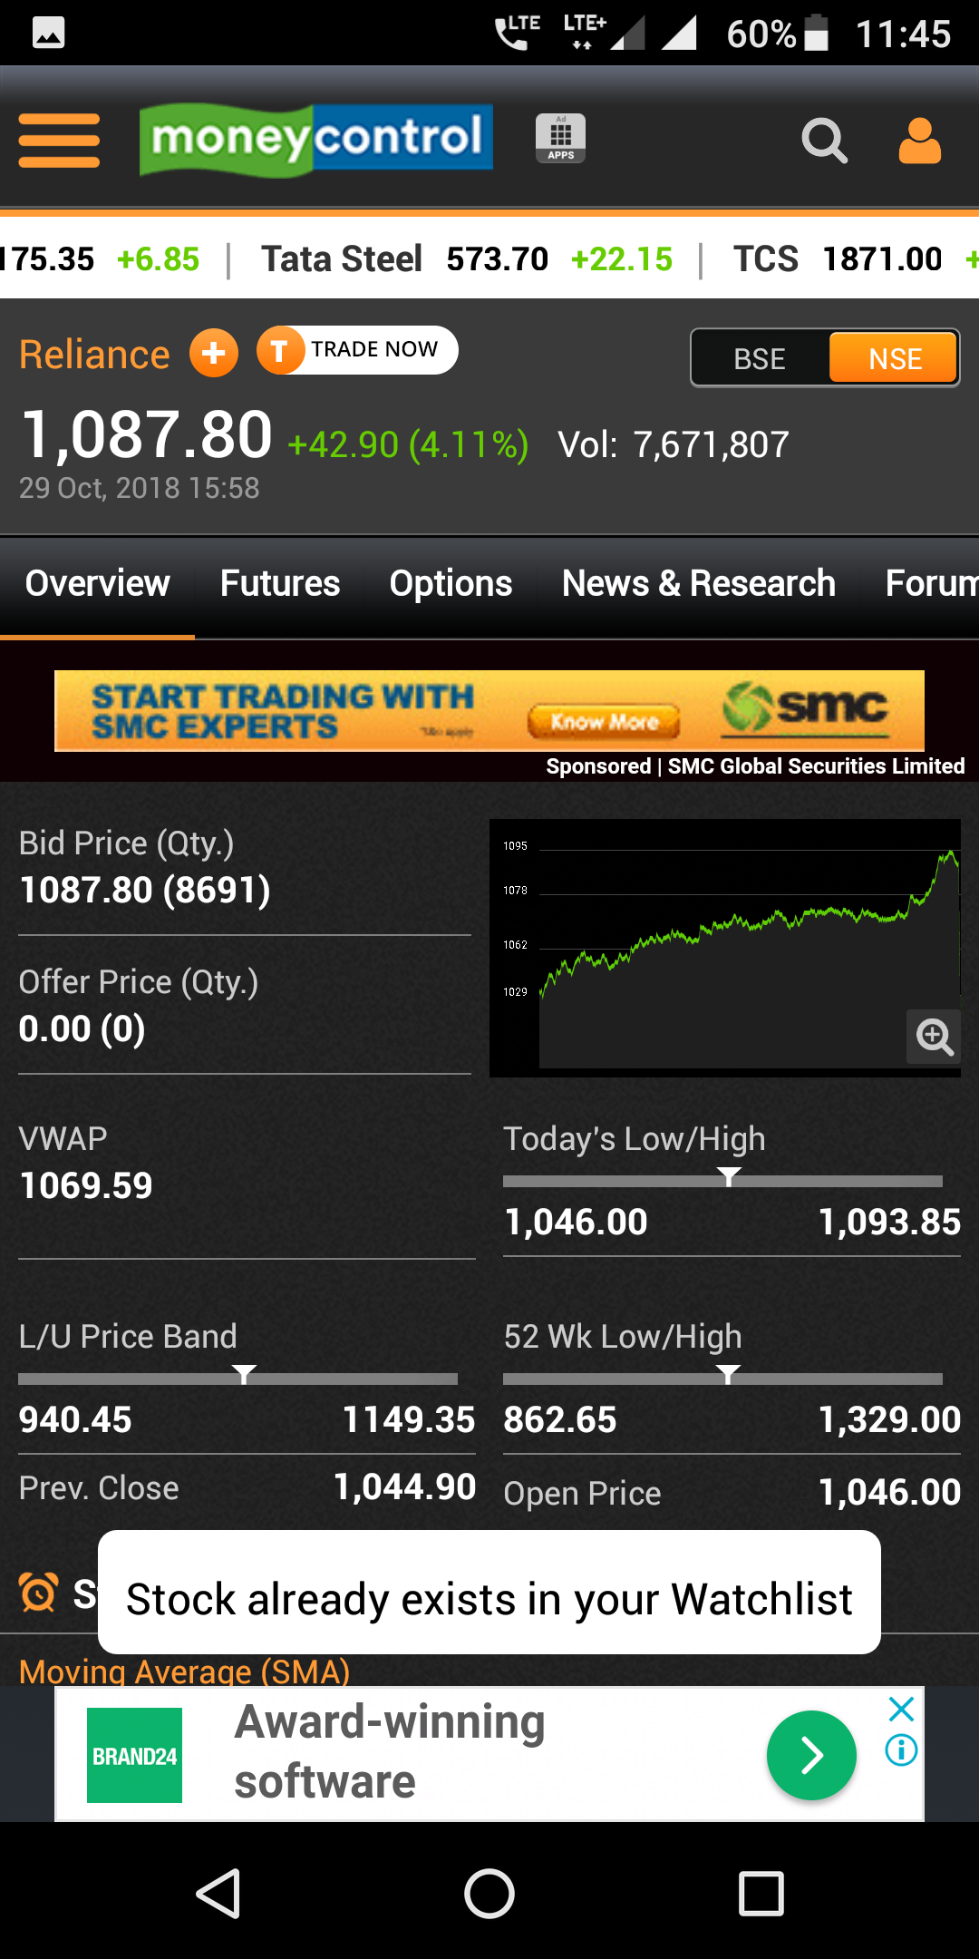
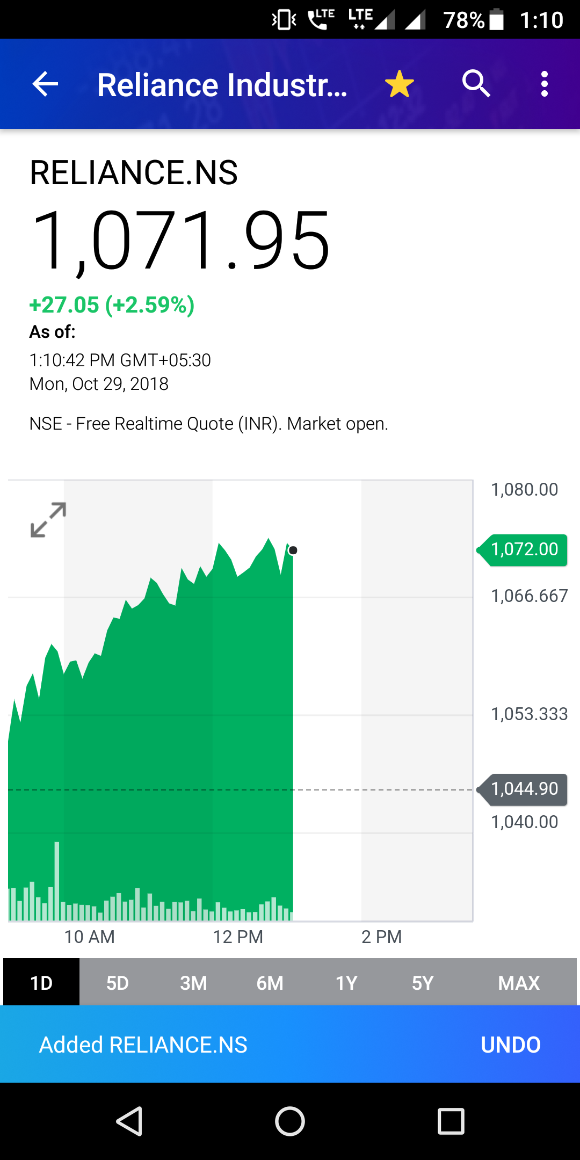
4) Design Dialogues to yield
closure
When we add the share to the watchlist, one message is displayed.(Add or remove)
ShareKhan
Money Control
Yahoo Finance

Slide 14
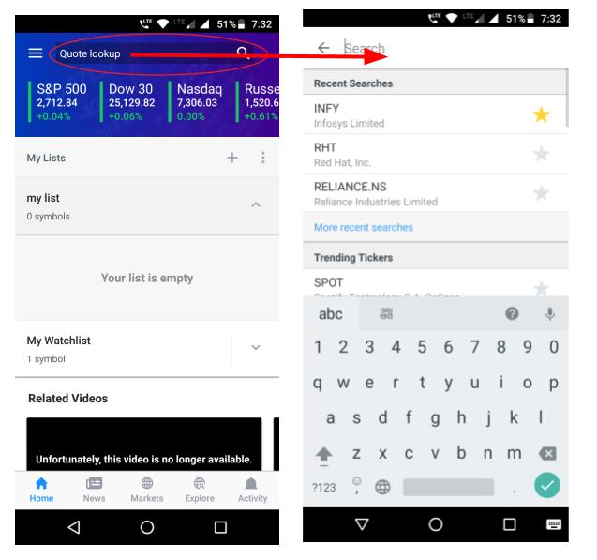
5) Offer error prevention and simple
error handling
In Yahoo Finance, error prevention is taken care in searching a share as the entire row can be used for searching by clicking anywhere in entire row.

Slide 15

6)Permit easy reversal of actions
Undo option is provided in Yahoo Finance app if we have added any share by mistake while the same facility is not available in Sherkhan and Money Control.

Slide 16
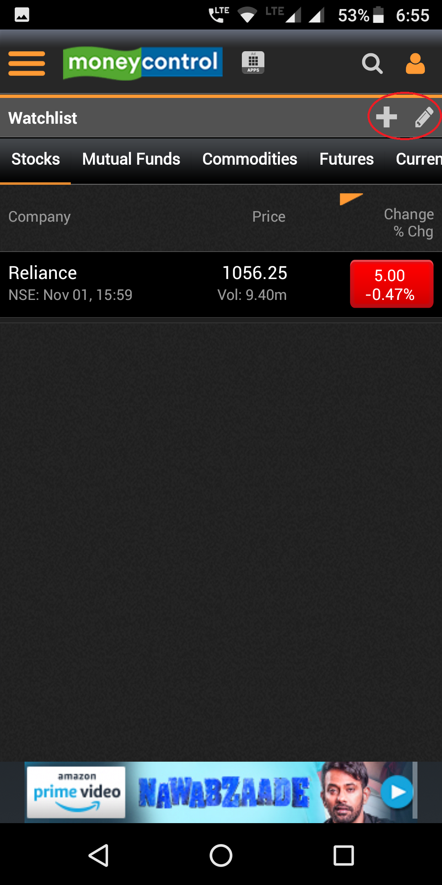
7)Support internal locus of control
In moneycontrol app, the button size were too small, which lead to misclicking consuming more time to accomplish the task.
In moneycontrol app, too many advertisements occurred which leaded to tedious process of back button which made the task time consuming. (Surprising system response)

Slide 17
UI/UX Based Survey
In this survey, we asked some question which are related to application’s designing contexts.
This survey was carried out only for those user who have used or using any of the apps from yahoo finance, sharekhan or moneycontrol.
Here we concluded some positive points of apps form results.

Slide 18
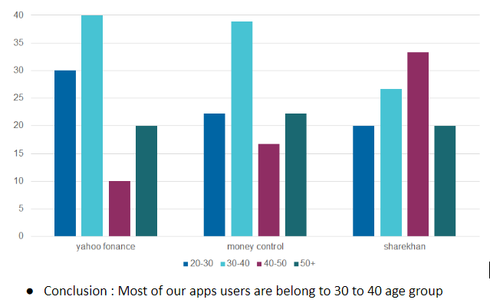
Age Group:

Slide 19
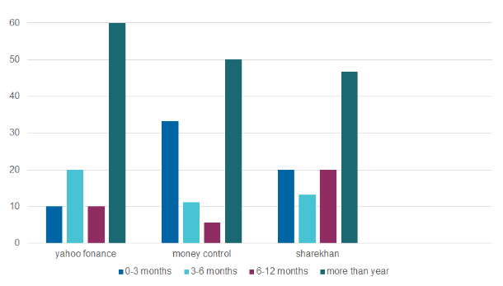
For how much time are you using app (YahooFinance or Sharekhan or Moneycontrol)?

Slide 20
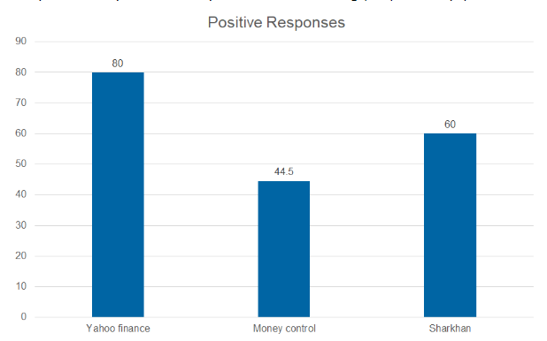
The menu items were well organized and functions were easy to find (means Can you find all your necessary task tools like settings,help... easily?)
Conclusion: yahoo Finance stand ahead of all other followed by sharekhan and money control

Slide 21
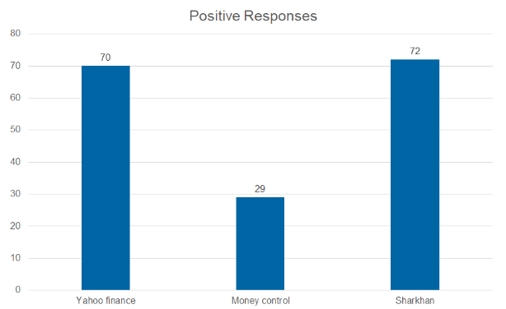
You immediately understood the function of each menu item. (means Can you understand what is the use of all tools by just looking at it?)

Slide 22
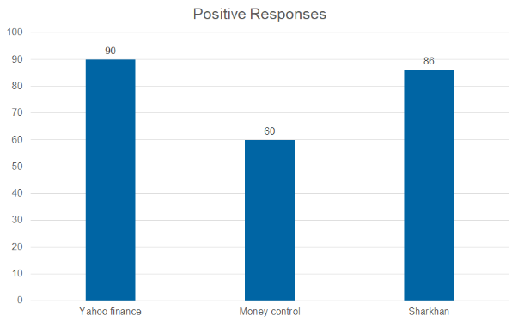
All of the functions you expected to find inthe menus were present (means are you satisfied with current tools in menu? Or are you need some extra tool for your activites?)
Conclusion :in yahoo and sharekhan users were able to easily find tools but in money control it was difficult to find tools it has too many options in it’s manu.

Slide 23
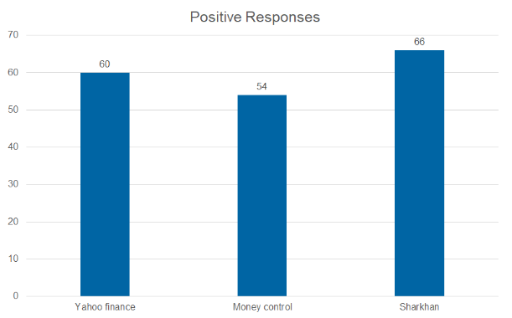
The buttons were well organized and easy to find. (means there are some shortcuts for some tool to quick access. Can you find them easily on screen ?)
Conclusion :yahoo was easiest and sharekhan was hardest to explore.

Slide 24
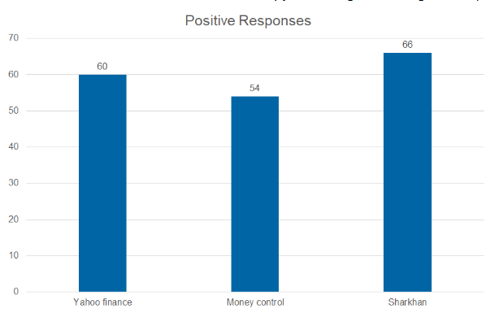
.You immediately understood the function of each Button. (means Can you understand what is the use of each button by just looking its drawing or text?)
Conclusion : Some users of Money Control have difficulties in understanding the functions of each buttons.

Slide 25
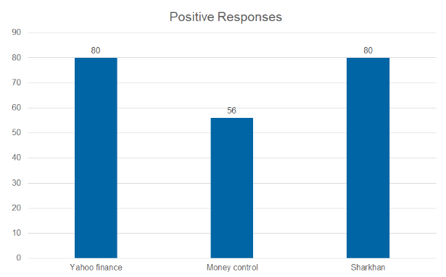
All of the functions you expected to find on the button bar were present.(means are you satisfied with current shortcuts of tools on home screen? Or are you need some extra tool’s shortcut for your activities?)

Slide 26
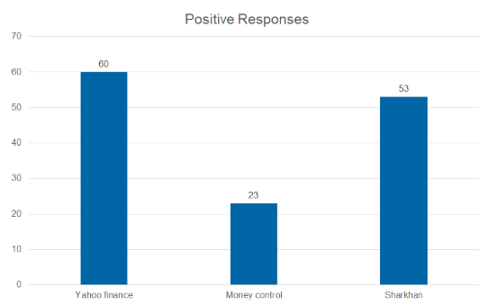
.You found navigating around the your Application screen tobe (means Can you go one tool to another tool easily?

Slide 27
What would be the rate of the your Application's UI/UX is?

Slide 28
What would be the rate of the service provided by app is?

Slide 29
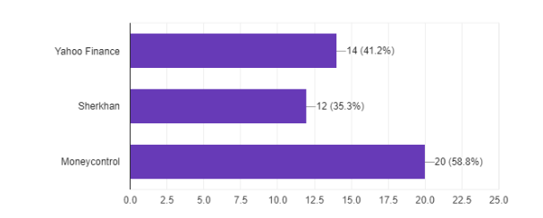
.Design Based Survey :
1.Which login page pattern would you prefer?
(1)email and password
(2)mobile number with OTP
(3) email and password with google or facebook login facilities.

Slide 30
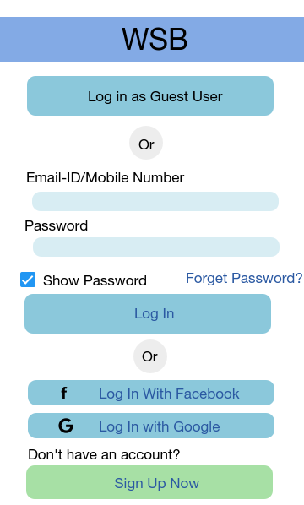
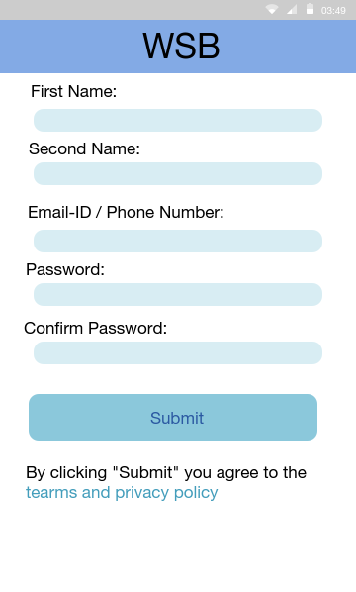
Prototype

Slide 31
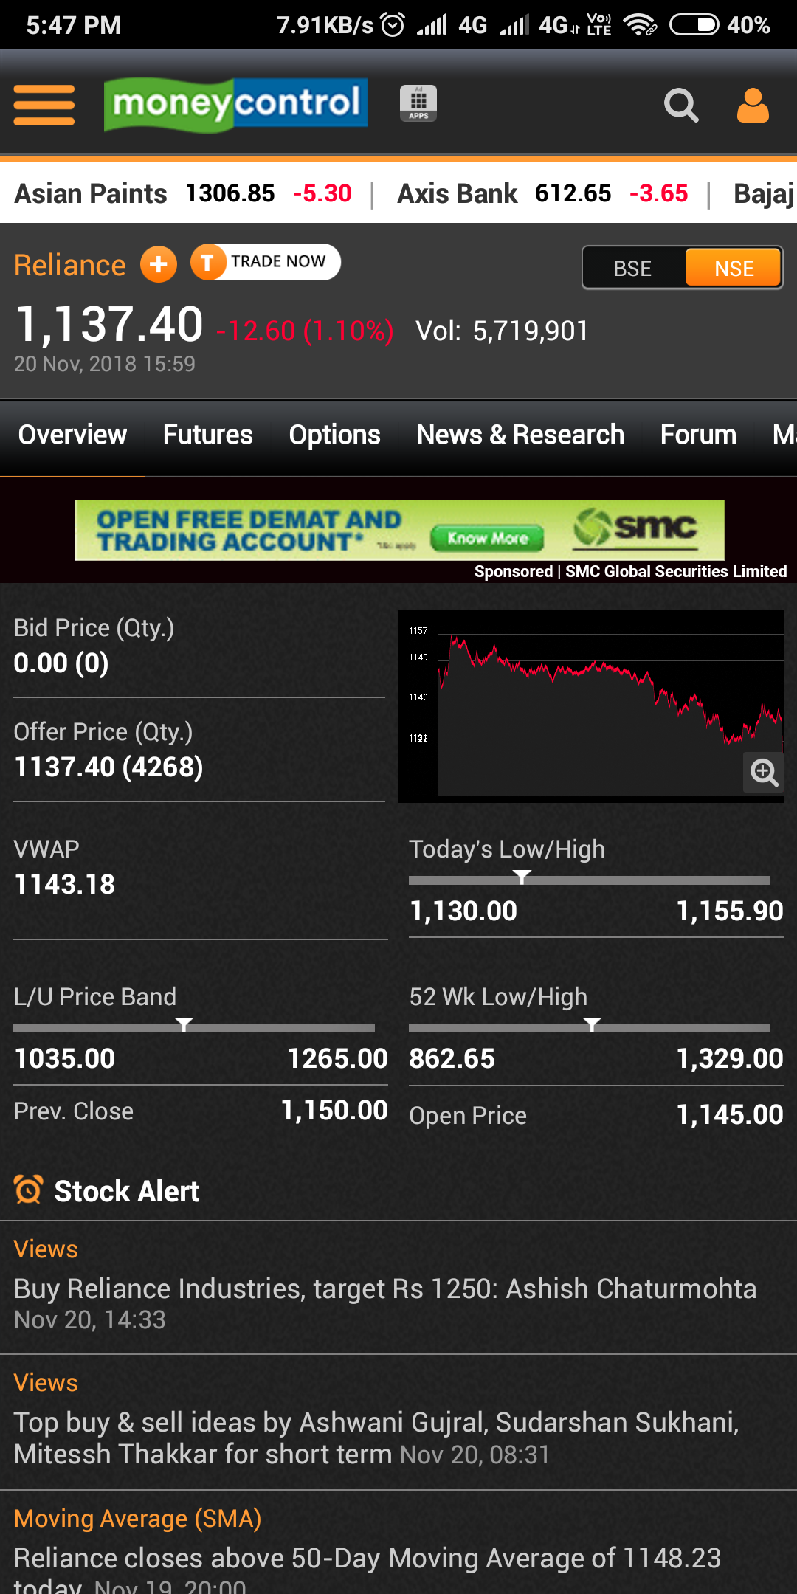
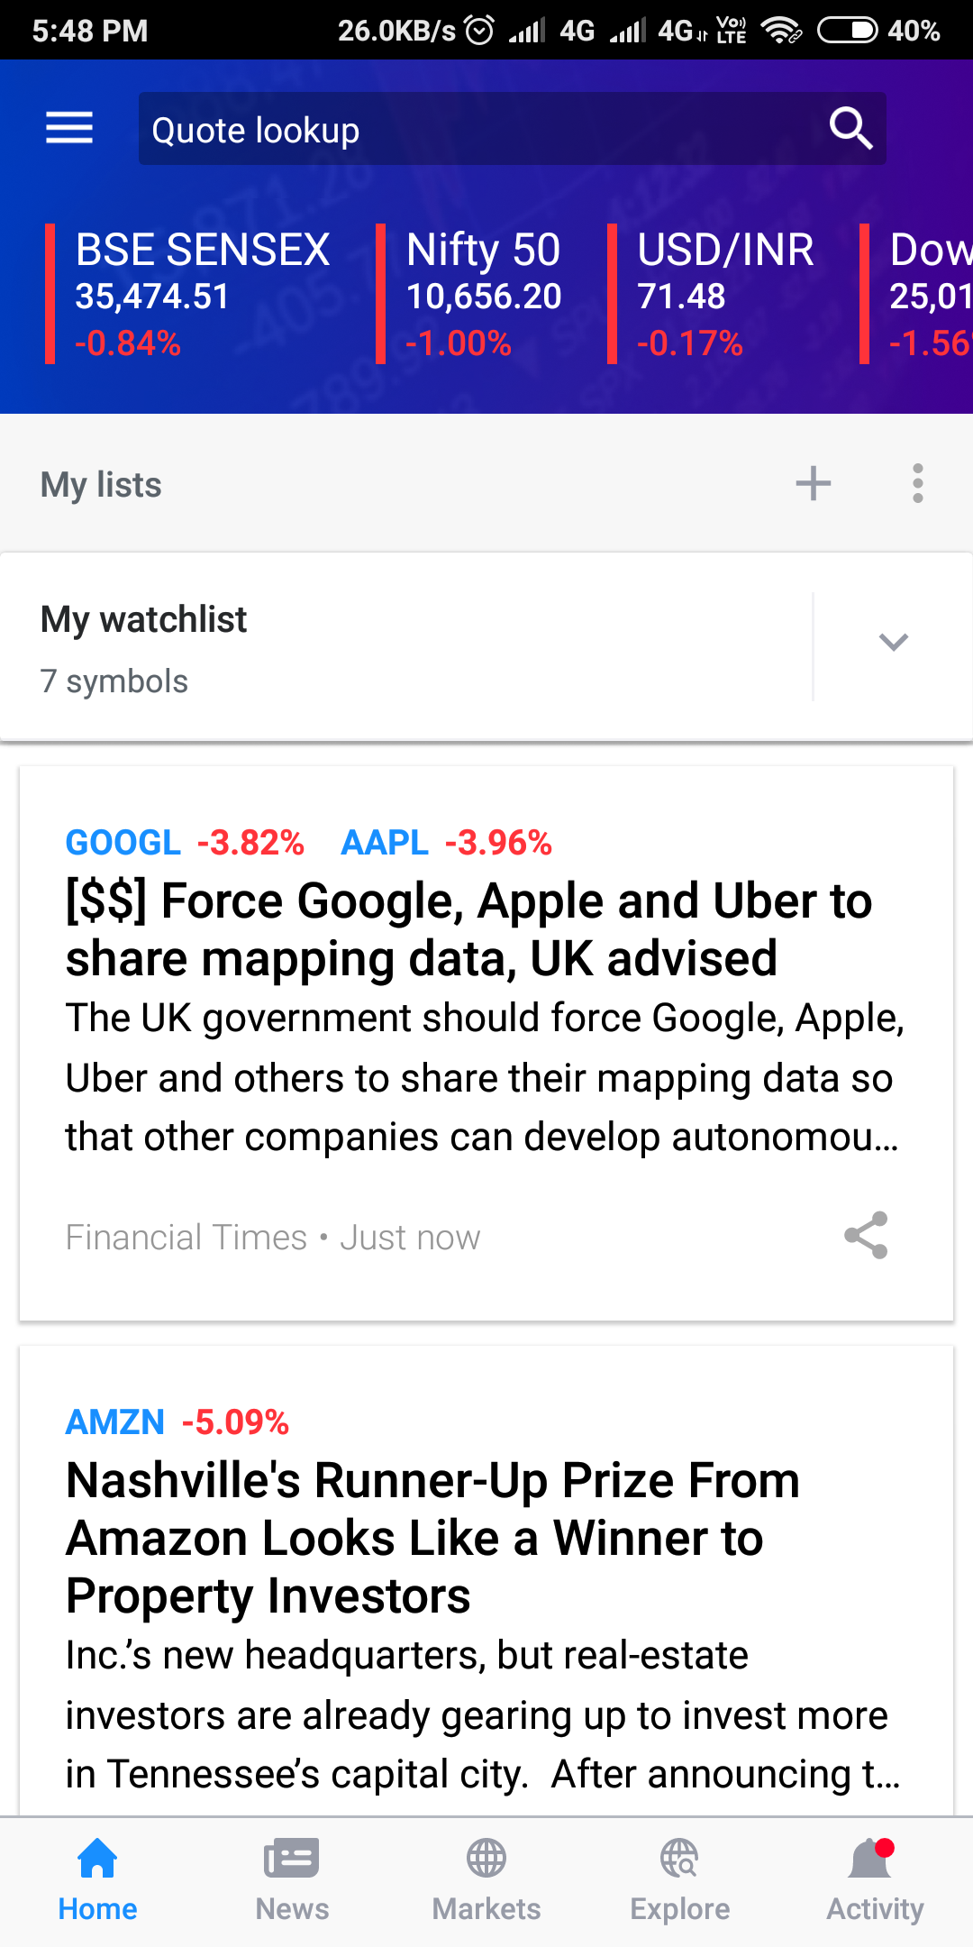
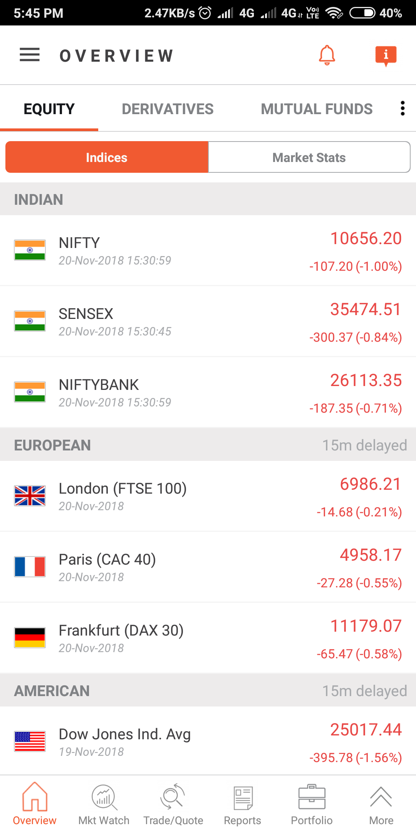

Slide 32
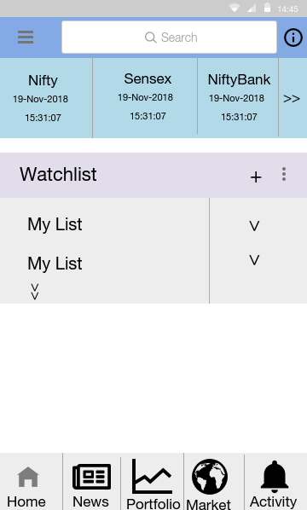
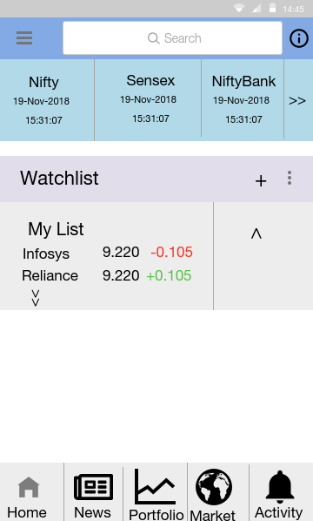
Prototype

Slide 33
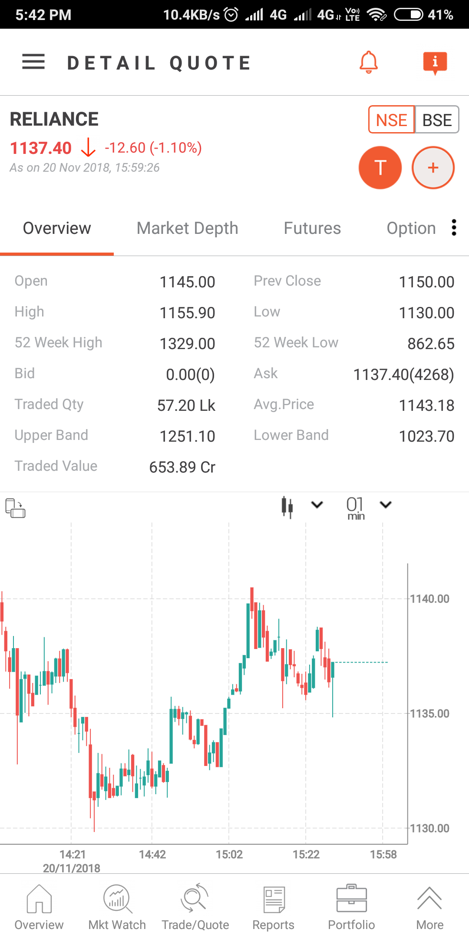
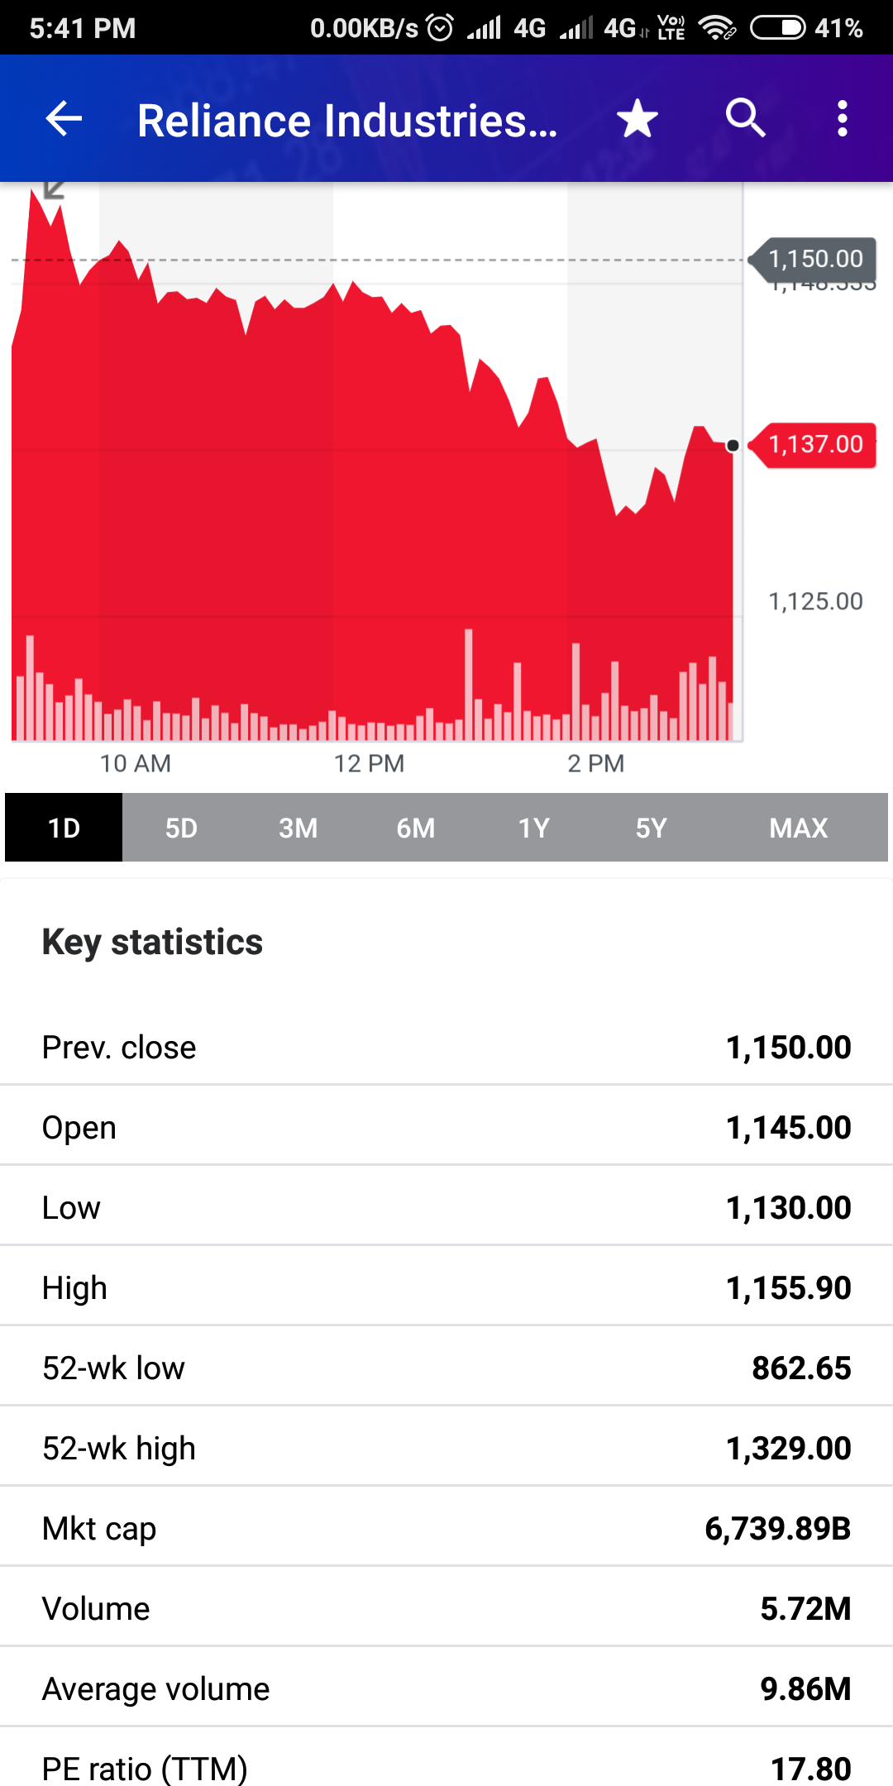
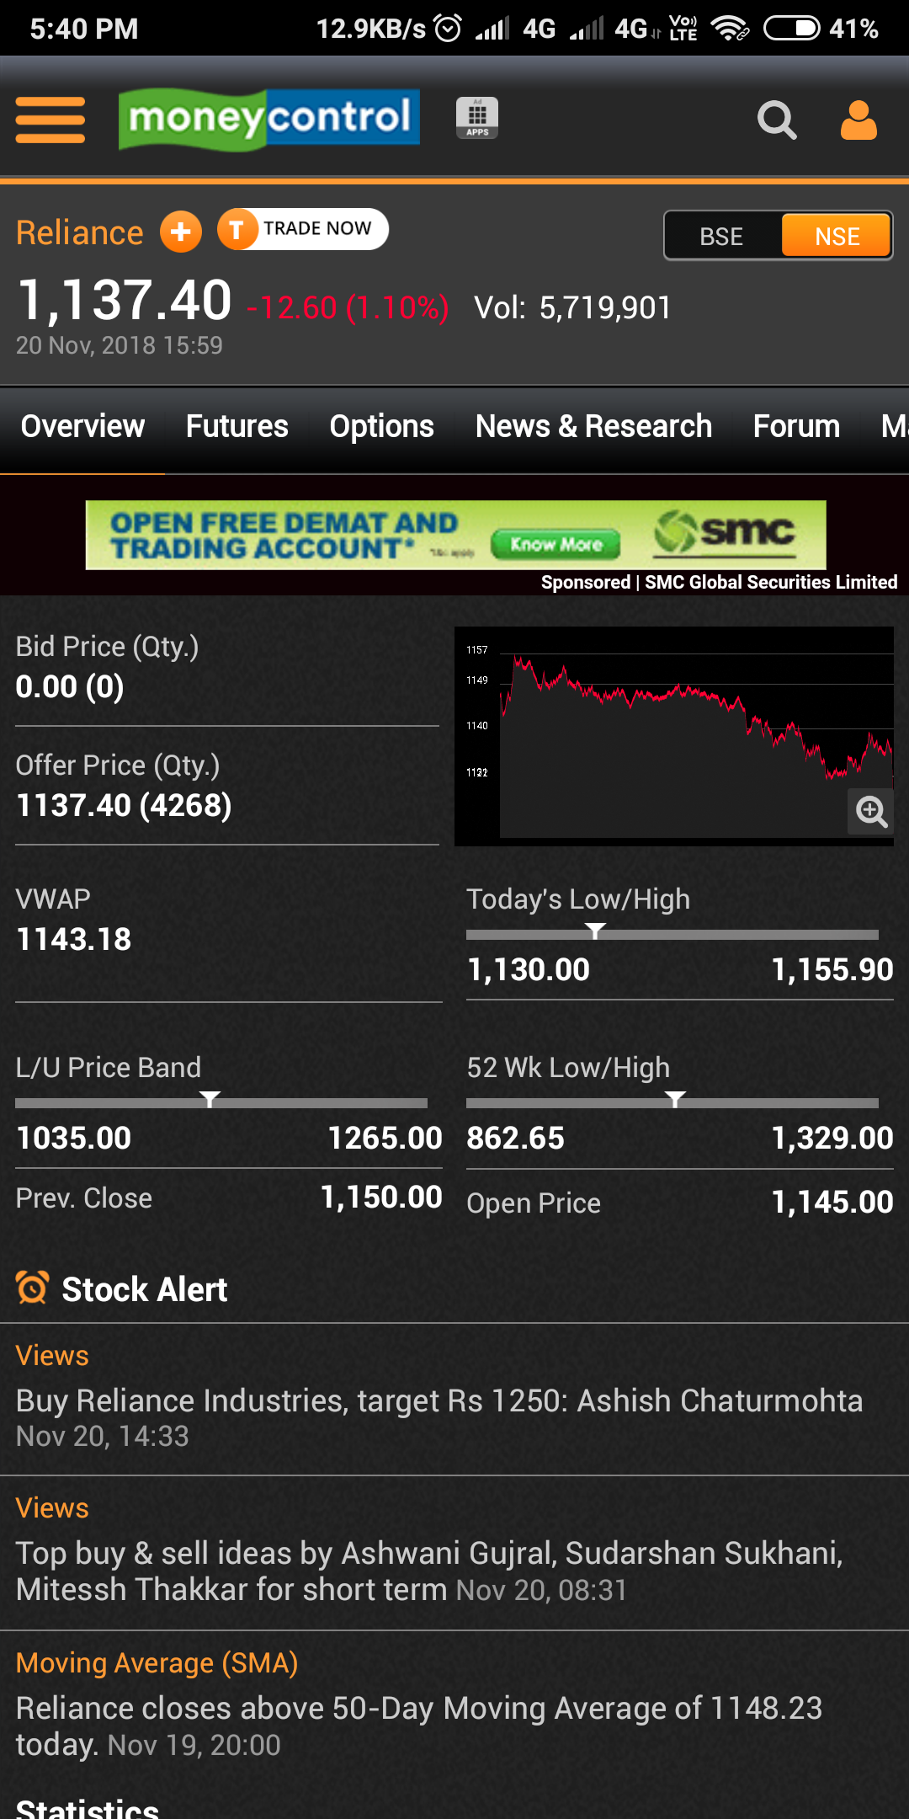

Slide 34
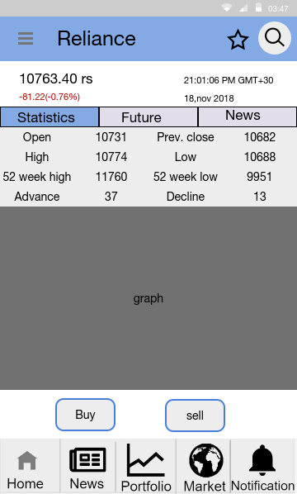
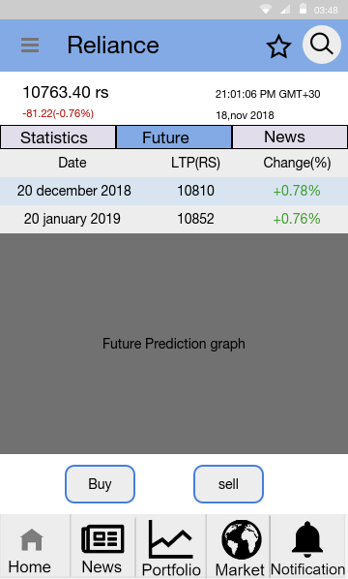
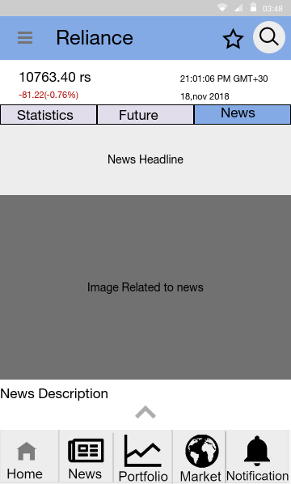
Prototype
34

Slide 35
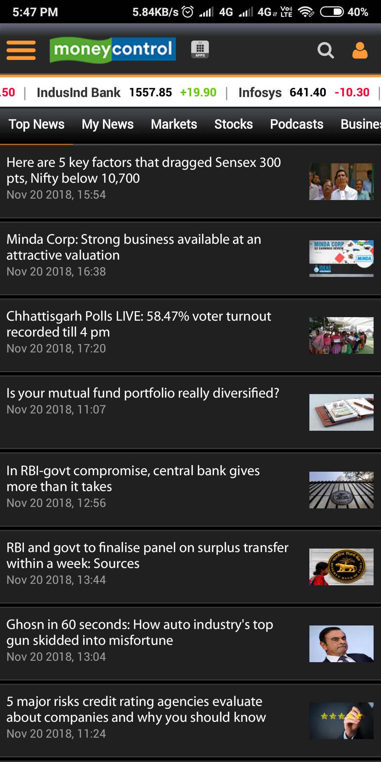
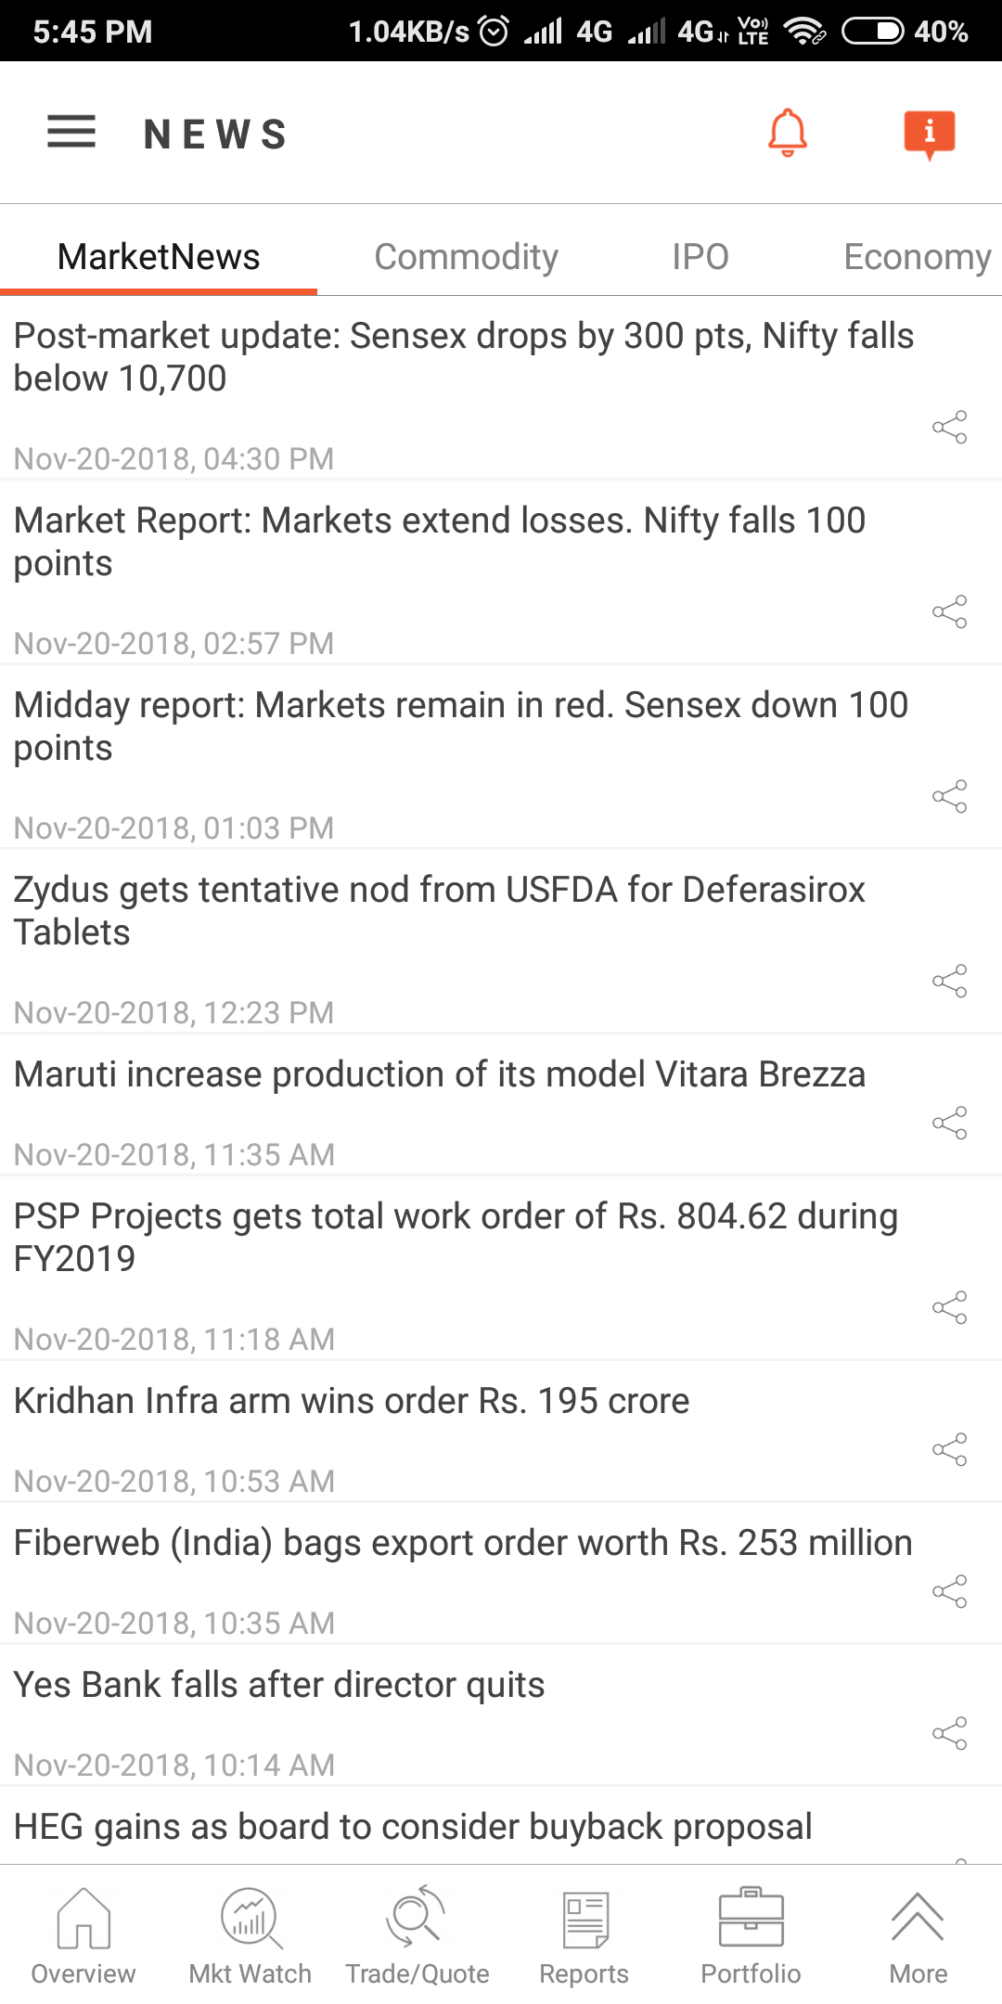
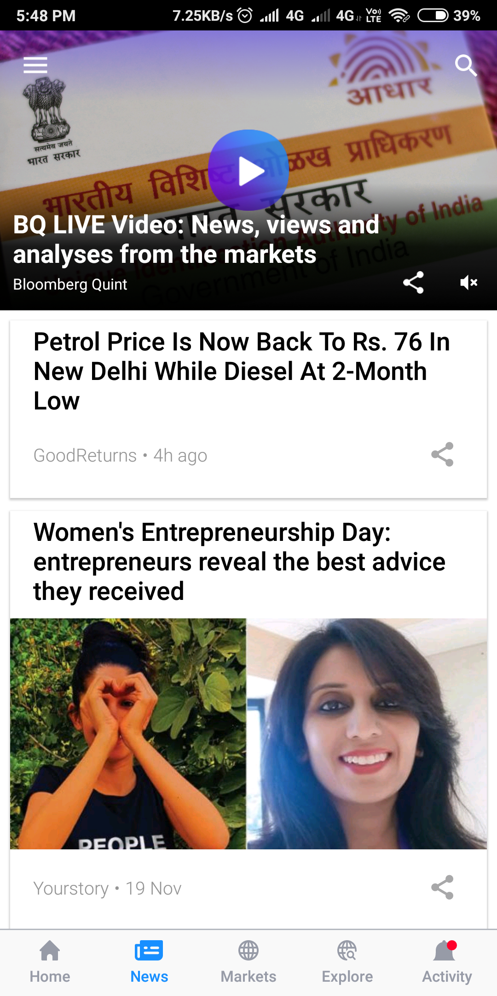

Slide 36
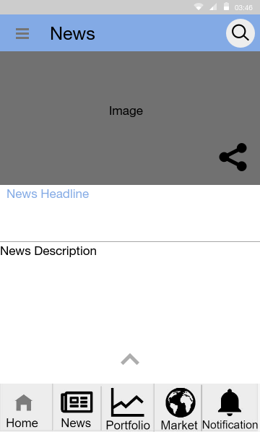
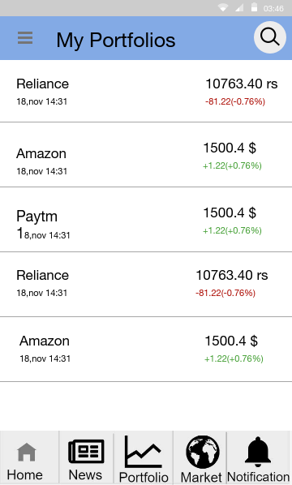
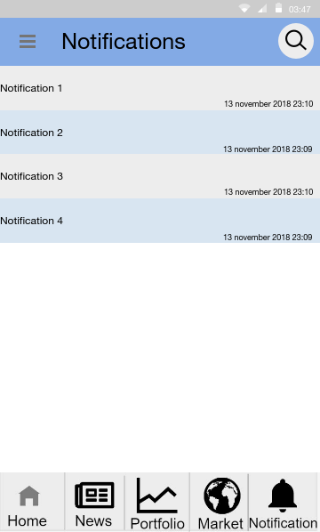
Prototype

Slide 37
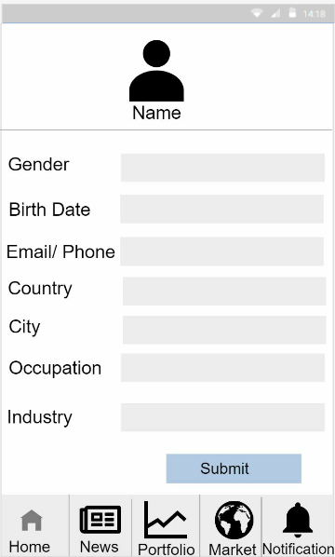
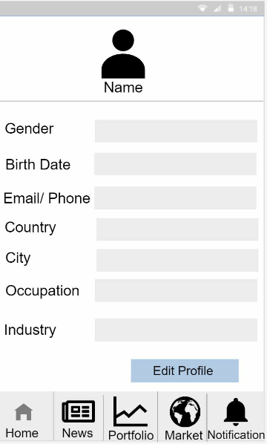
Prototype

Slide 38
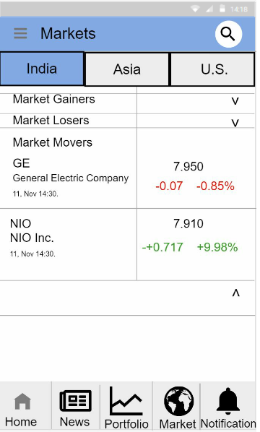
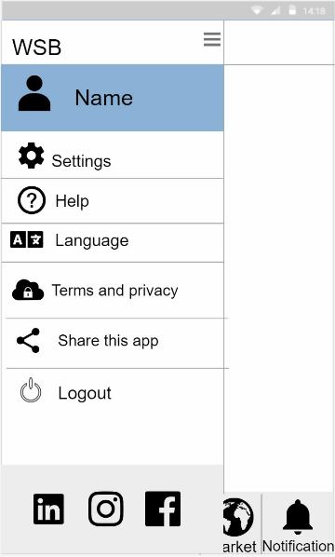
Prototype

Slide 39
Thank You

